Slide 1
Multilevel Wavelet Decomposition Network for Interpretable Time Series Analysis
——SIGKDD 2018
Jingyuan Wang, Ze Wang, Jianfeng Li, JunjieWu∗
Beihang University

Slide 2
Introduction
Background
Methods
Experiments
Interpretation
Conclusion

Slide 3
1. Introduction
Motivation:
Various types of deep neural network models have been introduced to time series analysis, but the important frequency information is yet lack of effective modeling
Contributions:
A wavelet-based neural network structure called multilevel Wavelet Decomposition Network (mWDN)
Based on mWDN, we further propose two deep learning models called Residual Classification Flow (RCF) and multi-frequency Long Short-Term Memory (mLSTM) for time series classification and forecasting, respectively
We propose an importance analysis method to mWDN based models, which successfully identifies those time-series elements and mWDN layers that are crucially important to time series analysis

Slide 4
1. Introduction
MDWD
RCF
classification
mWDN
mLSTM
forecasting
Importance analysis

Slide 5
2. Background
Time-domain and frequency-domain
RNN/LSTM/CNN (without frequency information)
Wavelet decompositions like Multilevel Discrete Wavelet Decomposition (MDWD) are well-known methods for capturing features of time series both in time and frequency domains (feature engineering tool but are not globally optimized with independent parameter)
Notes:
1.时域是针对序列的原始值来做的分析，频域是针对数据的频率信息
2.大部分深度学习模型仅利用了时域信息，没有利用频域信息
3.小波分解能从时域和频域中获取特征，但是参数是独立的，不能通过结果来进行全局的参数优化

Slide 6
2. Background
Time Series Classification (TSC): assign a time series pattern to a specific category
Distance based: DTW with KNN classifier
Feature based: shapelets mining, attention and deep learning based representative learning
Ensemble methods
Time Series Forecasting (TSF): predict future values of a time series using past and present data
ARIMA
RNN/LSTM
Frequency Analysis of Time Series: has been deeply studied by the signal processing community
Discrete Wavelet Transform
Discrete Fourier
Z-Transform
Notes:
1.Shapelets
2.整合移动平均自回归模型

Slide 7





3. Methods
Low pass filter [0.5, 0.5]
High pass filter [0.5, -0.5]
3.1 Multilevel Discrete Wavelet Decomposition (MDWD)
Level 0:
2 | 4 | 8 | 10 | 8 | 4 | -2 | -2
L
$$x^{l}(0)$$
H
3 | 6 | 9 | 9 | 6 | 1 | -2 | -1
-1 | -2 | -1 | 1 | 2 | 3 | 0 | -1
Level 1:
Average Pooling
Average Pooling
4.5 | 9 | 3.5 | -1.5
-1.5 | 0 | 2.5 | -0.5
H
$$x^{h}(1)$$
L
6.75 | 6.25 | 1 | -0.75
-2.25 | 2.75 | 2.5 | -0.75
Average Pooling
Average Pooling
Level 2:
6.5 | 0.125
0.25 | 0.875
$$x^{l}(2)$$
$$x^{h}(2)$$
$$χ\left(2\right)=\left\{x^{h}\left(1\right), x^{h}\left(2\right), x^{l}(2)\right\}$$
Notes:
1.实际上就是一维卷积

Slide 8





3. Methods
3.1 Multilevel Discrete Wavelet Decomposition (MDWD)
Input time series:
Low pass filter:
High pass filter:
Sub-series set:
$$x=\left\{x_{1},…,x_{t},..,x_{T}\right\}$$
$$l=\left\{l_{1},…,l_{k},..,l_{K}\right\}$$
$$K≪T$$
$$h=\left\{h_{1},…,h_{k},..,h_{K}\right\}$$
$$χ\left(i\right)=\left\{x^{h}\left(1\right), x^{h}\left(2\right), …,x^{h}\left(i\right), x^{l}(i)\right\}$$
Notes:
因为是顺序计算的，所以也包含时间信息

Slide 9
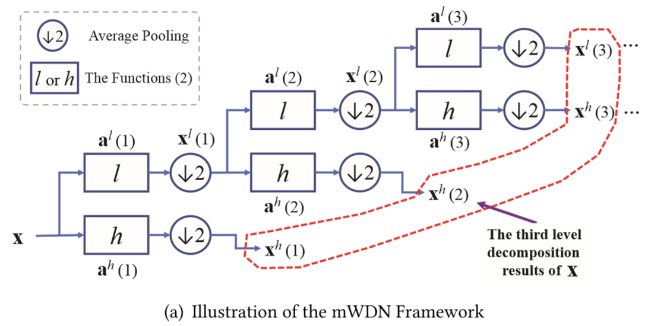
3. Methods
3.2 Multilevel Wavelet Decomposition Network (mWDN)

Slide 10
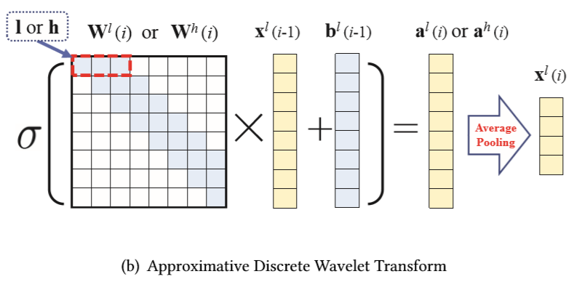
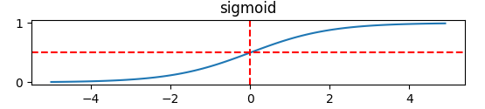
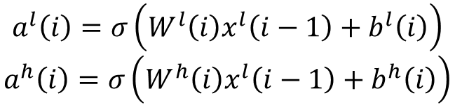
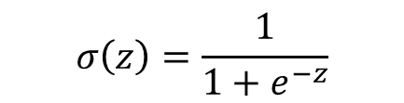
3. Methods
3.2 Multilevel Wavelet Decomposition Network (mWDN)
$$a^{l}\left(i\right)=σ\left(W^{l}\left(i\right)x^{l}\left(i−1\right)+b^{l}\left(i\right)\right)$$
$$a^{h}\left(i\right)=σ\left(W^{h}\left(i\right)x^{l}\left(i−1\right)+b^{h}\left(i\right)\right)$$
$$σ\left(z\right)=\frac{1}{1+e^{−z}}$$

Slide 11
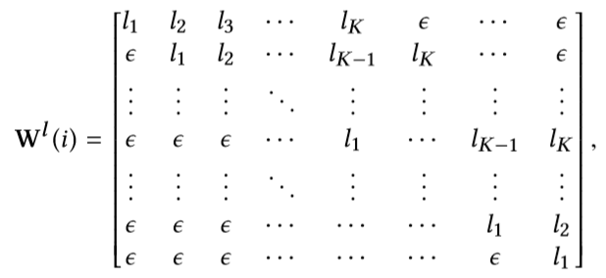
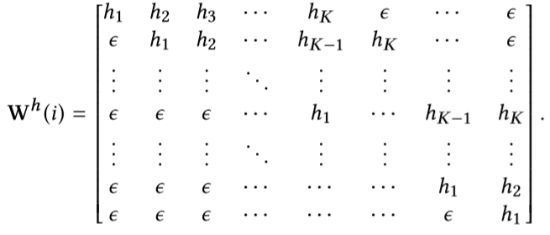
3. Methods
3.2 Multilevel Wavelet Decomposition Network (mWDN)
$ε is random value that satisfy \left|ε\right|≪\left|l\right|, ∀l∈l$ and$\left|ε\right|≪\left|h\right|, ∀h∈h$
Initial: $l=\left\{−0.0106,0.0329,0.0308,−0.187,−0.028,0.6309,0.7148,0.2304\right\},$
$$h=\left\{−0.2304,0.7148,−0.6309,−0.028,0.187,0.0308,−0.0329,−0.0106\right\}.$$

Slide 12
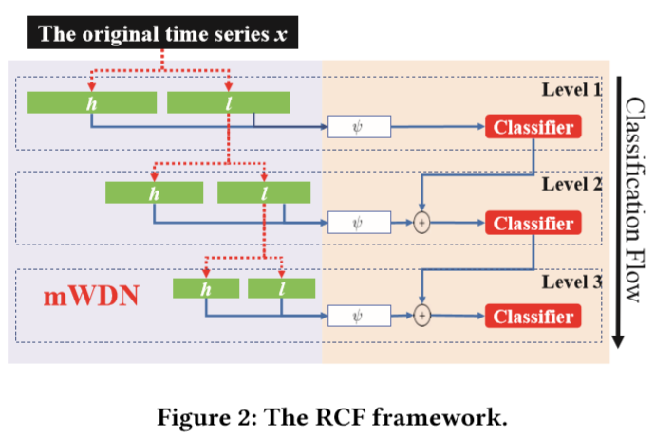



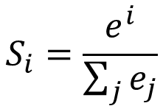




3. Methods
$$u\left(i\right)=ψ\left(x^{h}\left(i\right),x^{l}\left(i\right),θ^{ψ}\right)$$
3.3 Residual Classification Flow (RCF)
$$\hat{c}=S\left(\hat{c}\left(i−1\right)+u\left(i\right)\right)$$
$$ψ$$
$$S_{i}=\frac{e^{i}}{\sum_{j}{e_{j}}}$$
$$ψ$$
$$+$$
$$ψ$$
$$+$$
Notes:
connect

Slide 13
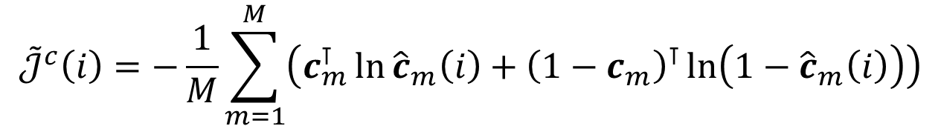



3. Methods
3.3 Residual Classification Flow (RCF)
Given a set of time series:
Objective function of the $i$-th classifier:
Final objective function:
$$\left\{x_{1},x_{2},…,x_{M}\right\}$$
$${\tilde{𝒥}}^{c}\left(i\right)=−\frac{1}{M}\sum_{m=1}^{M}{\left(c_{m}^{⊺}\ln{{\hat{c}}_{m}\left(i\right)+{\left(1−c_{m}\right)}^{⊺}\ln\left(1−{\hat{c}}_{m}\left(i\right)\right)}\right)}$$
$$𝒥^{c}=\sum_{i=1}^{N}{\frac{i}{N}}{\tilde{𝒥}}^{c}\left(i\right)$$
Notes:
交叉熵作为每一层的代价函数

Slide 14
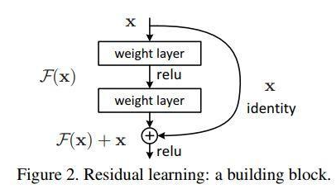
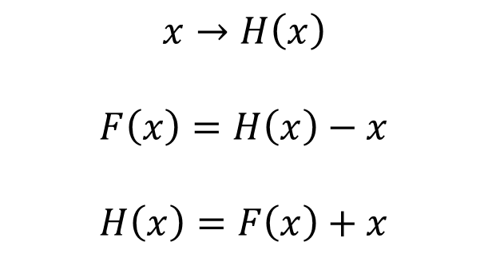
3. Methods
3.3 Residual Classification Flow (RCF)
ResNet
$$x→H\left(x\right)$$
$$F\left(x\right)=H\left(x\right)−x$$
$$H\left(x\right)=F\left(x\right)+x$$

Slide 15
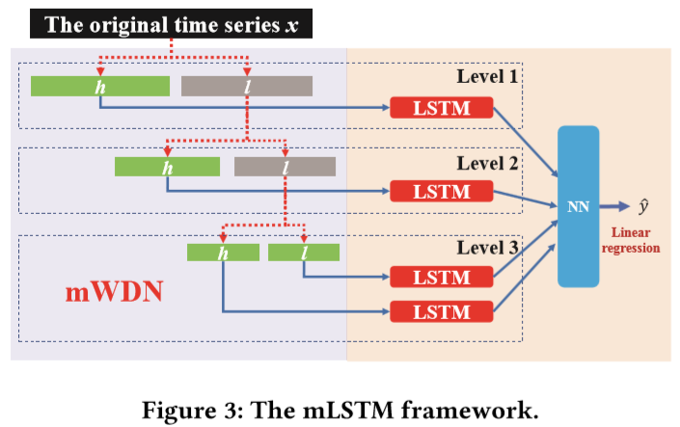







3. Methods
3.4 Multi-frequency Long Short-Term Memory (mLSTM)
$$x=\left\{x_{t−T+1},…,x_{t−1},x_{t}\right\}$$
$$x_{t+1}$$
$${\hat{y}}_{1}$$
$${\hat{y}}_{2}$$
$$\hat{y}$$
$${\hat{y}}_{3}$$
$${\hat{y}}_{4}$$

Slide 16
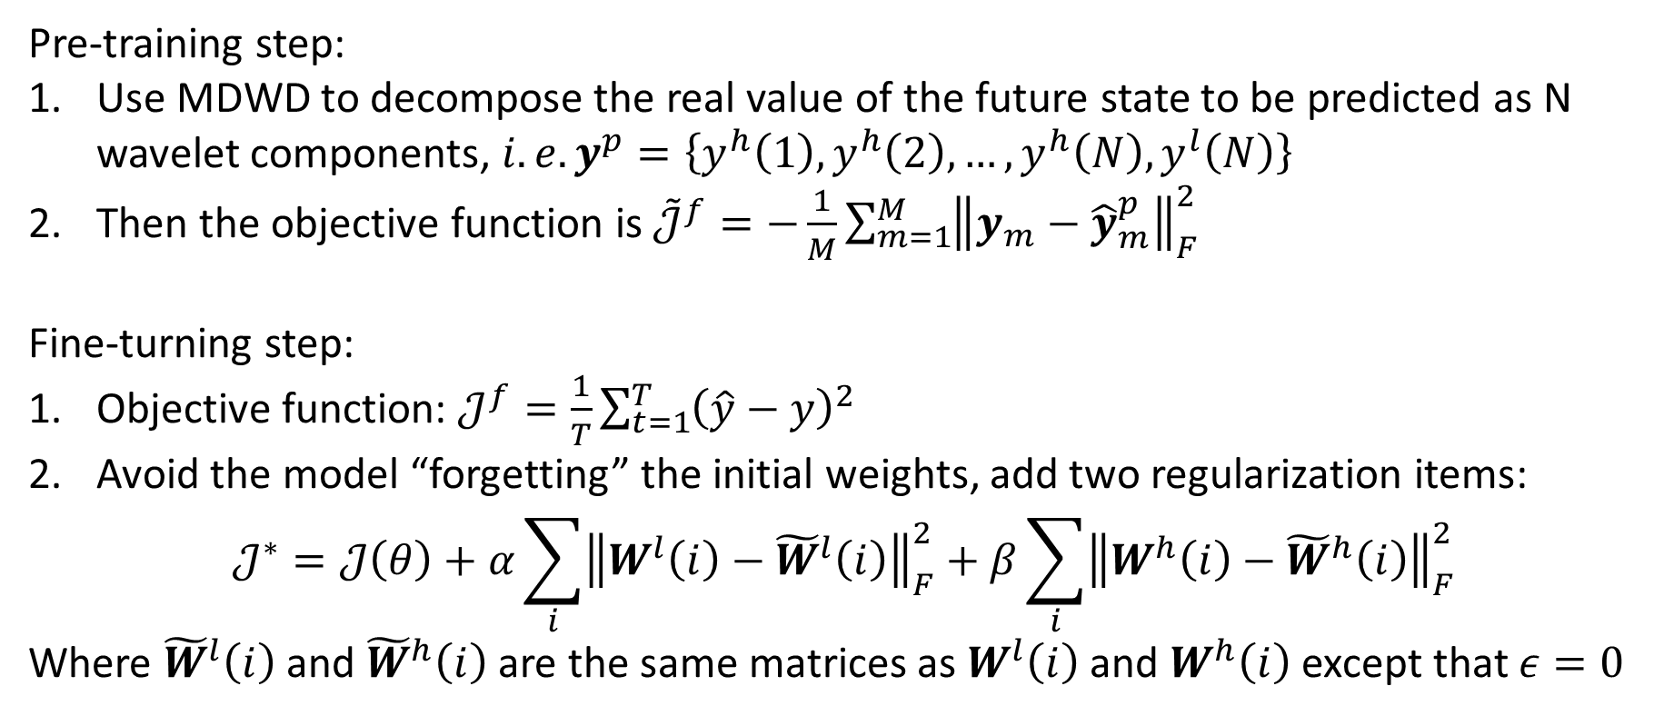
3. Methods
3.4 Multi-frequency Long Short-Term Memory (mLSTM)
Pre-training step:
Use MDWD to decompose the real value of the future state to be predicted as N wavelet components, $i.e. y^{p}=\left\{y^{h}\left(1\right),y^{h}\left(2\right),…,y^{h}\left(N\right),y^{l}\left(N\right)\right\}$
Then the objective function is ${\tilde{𝒥}}^{f}=−\frac{1}{M}\sum_{m=1}^{M}{{\left\|y_{m}−{\hat{y}}_{m}^{p}\right\|}_{F}^{2}}$
Fine-turning step:
Objective function: $𝒥^{f}=\frac{1}{T}\sum_{t=1}^{T}{{\left(\hat{y}−y\right)}^{2}}$
Avoid the model “forgetting” the initial weights, add two regularization items:
$$𝒥^{∗}=𝒥\left(θ\right)+α\sum_{i}{{\left\|W^{l}\left(i\right)−{\tilde{W}}^{l}\left(i\right)\right\|}_{F}^{2}}+β\sum_{i}{{\left\|W^{h}\left(i\right)−{\tilde{W}}^{h}\left(i\right)\right\|}_{F}^{2}}$$
Where ${\tilde{W}}^{l}\left(i\right)$ and ${\tilde{W}}^{h}\left(i\right)$ are the same matrices as $W^{l}\left(i\right)$ and $W^{h}\left(i\right)$ except that $ε=0$
Notes:
预训练：预测每个lstm生成的y组成的向量
微调参数：预测最终值

Slide 17
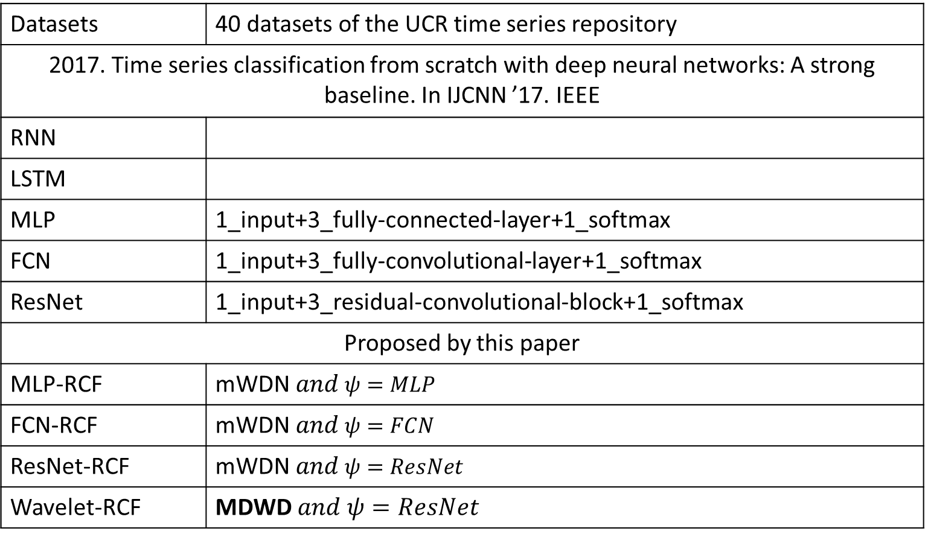
4. Experiments
Datasets | 40 datasets of the UCR time series repository
2017. Time series classification from scratch with deep neural networks: A strong baseline. In IJCNN ’17. IEEE
RNN
LSTM
MLP | 1_input+3_fully-connected-layer+1_softmax
FCN | 1_input+3_fully-convolutional-layer+1_softmax
ResNet | 1_input+3_residual-convolutional-block+1_softmax
Proposed by this paper
MLP-RCF | $$\text{mWDN} and ψ=MLP$$
FCN-RCF | $$\text{mWDN} and ψ=FCN$$
ResNet-RCF | $$\text{mWDN} and ψ=ResNet$$
Wavelet-RCF | $$\text{MDWD} and ψ=ResNet$$
4.1 TSC
Notes:
MLP/FCN/ResNet
MDWD表示特征固定，卷积核参数不可调

Slide 18
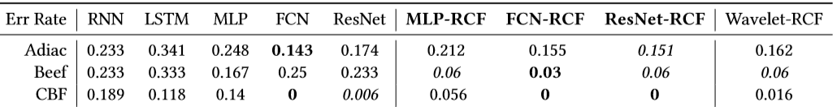
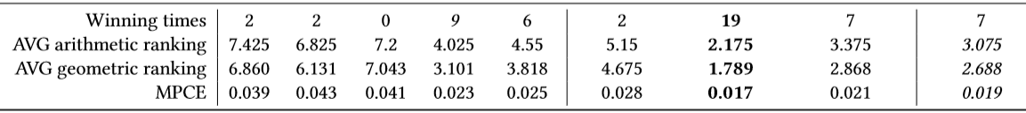
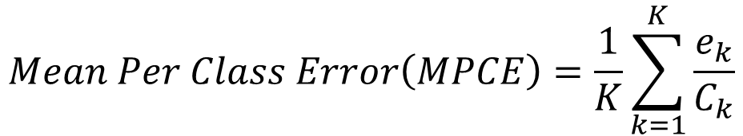
4. Experiments
4.1 TSC
$$Mean Per Class Error\left(MPCE\right)=\frac{1}{K}\sum_{k=1}^{K}{\frac{e_{k}}{C_{k}}}$$
The experiments also imply that the trainable parameters in a deep learning architecture and the strong priors from wavelet decomposition are two key factors for the success of RCF
Notes:
黑体表示第一，斜体表示第二
做10次取平均
算术排名
几何排名
使用了mWDN+RCF都比对应的网络模型要好；Wavelet-RCF表明频域也有很多信息；ResNet-RCF在很多数据集上表现优于Wavelet-RCF，所以优势在于参数可训练而不固定，所以这中间存在一个tradeoff

Slide 19
4. Experiments
4.1 TSF
Datasets | A real-life dataset named WuxiCellPhone containing 20 cell-phone base stations during two weeks and the time granularity is 5 minutes
Baselines
SAE | 2015. Traffic flow prediction with big data: A deep learning approach. IEEE T ITS
RNN
LSTM
Proposed by this paper
wLSTM | MDWD+mLSTM
mLSTM | mWDN+mLSTM
Notes:
SAE

Slide 20
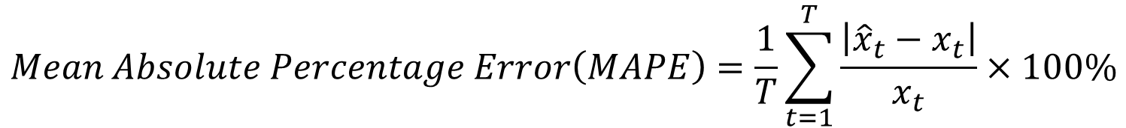
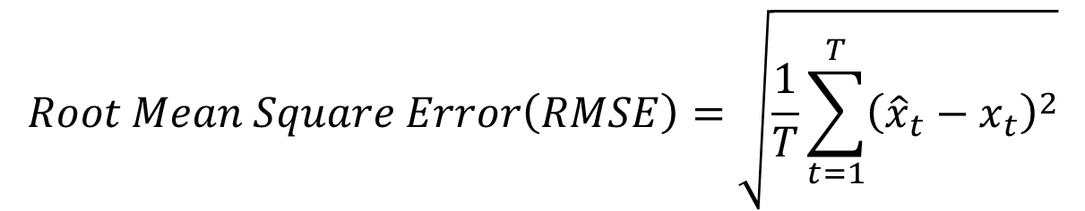
4. Experiments
4.1 TSF
$$Mean Absolute Percentage Error\left(MAPE\right)=\frac{1}{T}\sum_{t=1}^{T}{\frac{\left|{\hat{x}}_{t}−x_{t}\right|}{x_{t}}×100\%}$$
$$Root Mean Square Error\left(RMSE\right)=\sqrt{\frac{1}{T}\sum_{t=1}^{T}{{\left({\hat{x}}_{t}−x_{t}\right)}^{2}}}$$

Slide 21
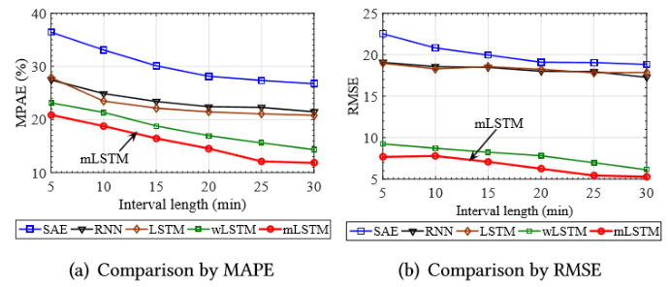
4. Experiments
Comparison of prediction performance with varying period lengths (Scenario I)
4.1 TSF
We predicted the average user volumes of a base station in subsequent periods. The length of the periods was varied from 5 to 30 minutes. Fig. 4 is a comparison of the performance averaged on the 20 base stations in one week.
Notes:
以不同的时间间隔做预测

Slide 22
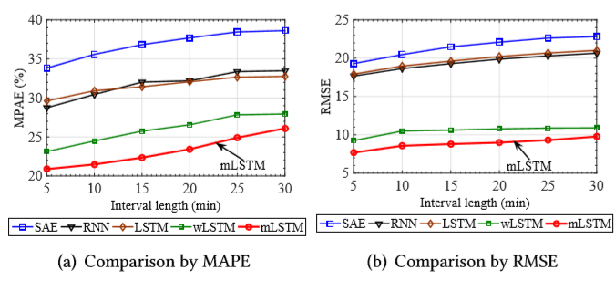
4. Experiments
Comparison of prediction performance with varying interval lengths (Scenario II)
4.1 TSF
We predicted the average user volumes in 5 minutes after a given time interval varying from 0 to 30 minutes
Notes:
以不同的时间间隔，只预测后5分钟的那个点

Slide 23
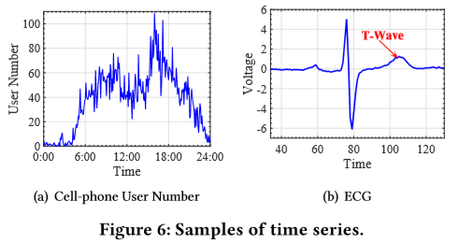
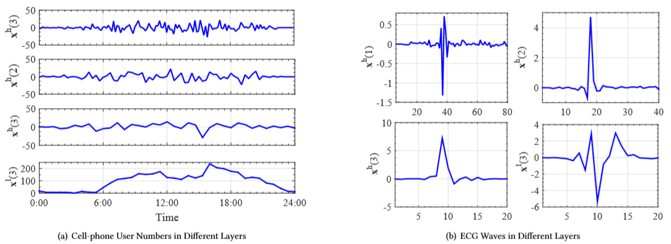
5. Interpretation
5.1 The Motivation
Notes:
Can we evaluate quantitatively what layer or which frequency of a time series is more important to the final output of the mWDN based models?

Slide 24
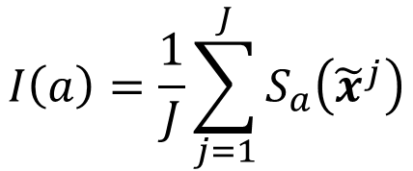

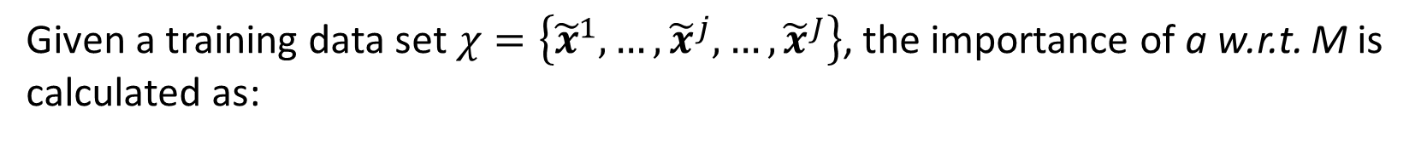

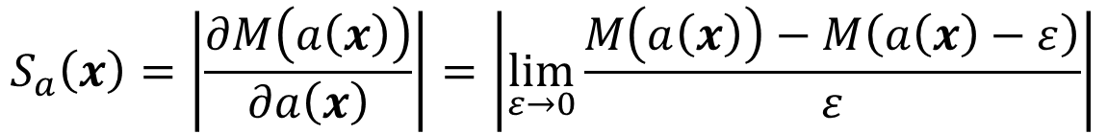
5. Interpretation
5.2 Importance Analysis
Prediction = Model(output(input series)):
$$p=M\left(a\left(x\right)\right)$$
$$a\left(x\right) means a=Wx$$
If a small disturbance $ε$ to the i-th element $x_{i}∈x$ can cause a large change to the output p, we say M is sensitive to $x_{i}$
$$S_{a}\left(x\right)=\left|\frac{∂M\left(a\left(x\right)\right)}{∂a\left(x\right)}\right|=\left|\lim_{ε→0}{\frac{M\left(a\left(x\right)\right)−M\left(a\left(x\right)−ε\right)}{ε}}\right|$$
Sensibility :
Given a training data set$χ=\left\{{\tilde{x}}^{1},…,{\tilde{x}}^{j},…,{\tilde{x}}^{J}\right\}$, the importance of a w.r.t. M is calculated as:
$$I\left(a\right)=\frac{1}{J}\sum_{j=1}^{J}{S_{a}\left({\tilde{x}}^{j}\right)}$$

Slide 25
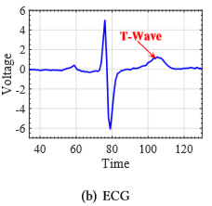
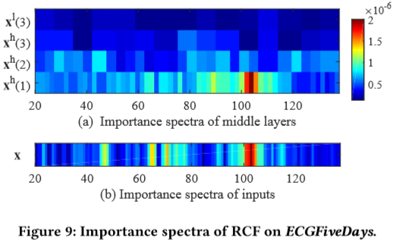
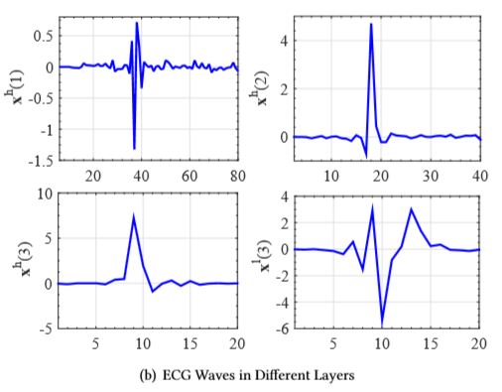
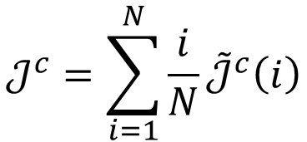
5. Interpretation
$$𝒥^{c}=\sum_{i=1}^{N}{\frac{i}{N}}{\tilde{𝒥}}^{c}\left(i\right)$$
5.3 Experimental Results
“We resize the lengths of the outputs to the same”
Notes:
低频滤波可以捕捉波形，高频滤波可以捕捉一些分辨度很高的信息更益于分类

Slide 26
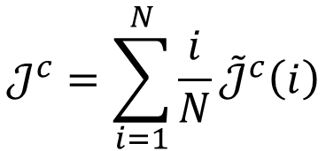
5. Interpretation
5.3 Experimental Results
$$𝒥^{c}=\sum_{i=1}^{N}{\frac{i}{N}}{\tilde{𝒥}}^{c}\left(i\right)$$
level | function | weight | importance
i=1 | ① | 1/3 | ①=2
i=2 | ①+② | 2/3 | ②=5/3
i=3 | ①+②+③ | 3/3 | ③=1
Notes:
低频滤波可以捕捉波形，高频滤波可以捕捉一些分辨度很高的信息更益于分类

Slide 27
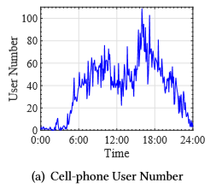
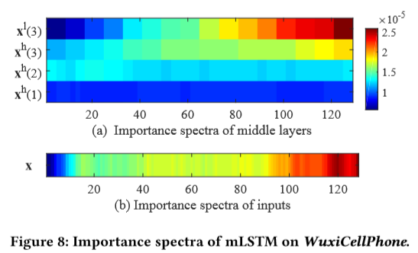
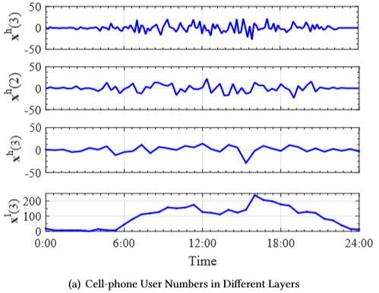
5. Interpretation
5.3 Experimental Results
Notes:
低频滤波容易捕捉波形、趋势。所有层数越高、越靠近后面的点，对于预测更有信息

Slide 28
6. Conclusion
Motivation: Aiming at building frequency-aware deep learning models for time series analysis
A novel wavelet-based network structure called mWDN for frequency learning of time series, which can then be seamlessly embedded into deep learning frameworks by making all parameters trainable.
Two deep learning models based on mWDN for time series classification and forecasting, respectively.
An importance analysis method for identifying important factors for time series analysis, which in turn verifies the interpretability merit of mWDN

Slide 29
6. Conclusion
Something good:
Transform the MDWD model into deep learning model and focus on the frequency
Take advantage of the level structure to build model
Something worth thinking about:
1. Combine the time and frequency information

